Slide 1
Switching Theory and Logic Design (STLD)
Theory - ETEC-205
B. Tech – 3rd Sem
August 2020 – January 2021
Faculty: Ms. Anubha Goel

Slide 2
STLD Lesson Plan

Slide 3
Outline of the lecture
Combinational circuits
Half adder
Full adder
Half subtractor
Full subtractor
binary Parallel adder
Binary adder-subtractor
Bcd adder
Serial adder
Look ahead carry adder

Slide 4
Combinational circuits
Combination logic circuits are the circuits whose outputs depend upon on the present input combination
The previous inputs or outputs do not alter the present outputs
They do not have memory
They can be represented by Boolean functions
Combinational circuit comprises of input variables, logic gates and output variables
Inputs and outputs are binary in nature i.e. can only take 0 or 1 as the possible values
‘n’ input variables
Combinational logic circuit
‘m’ output variables

Slide 5
Combinational circuits
Designing Procedure for combinational logic circuits will follow the steps as:
Input variables and output variables are identified and assigned distinct letter symbols
Truth table is derived, which states value of each output for all possible input combinations
Simplified Boolean expression is obtained for each output variable, either by K-map or Boolean algebra
Logic circuit is drawn using desired logic gates
Things to remember
‘n’ input variable will have 2^{n} input combination, therefore number of rows in truth table will be 2^{n}
For the system having ‘n’ input variables and ‘m’ output variables, the number of columns in truth table will be ‘n+m’

Slide 6
Combinational circuits
Combinational circuits that we need to study
Code Convertors
Adders
Subtractors
Magnitude Comparators
Parity bit Generators
Encoders and Decoders
Multiplexers and De-multiplexers

Slide 7
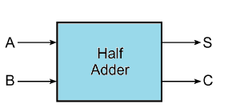
Half adder
Combinational circuit that performs arithmetic addition
Follows the rules of binary addition
The inputs are two binary bits, addend ‘A’ and augend ‘B’
The outputs are a sum bit ‘S’ and a carry bit ‘C’
The truth table for half adder (HA) with two inputs (A,B) and two outputs (S,C) is
Inputs |  | Outputs
A | B | S | C
0 | 0 | 0 | 0
0 | 1 | 1 | 0
1 | 0 | 1 | 0
1 | 1 | 0 | 1

Slide 8
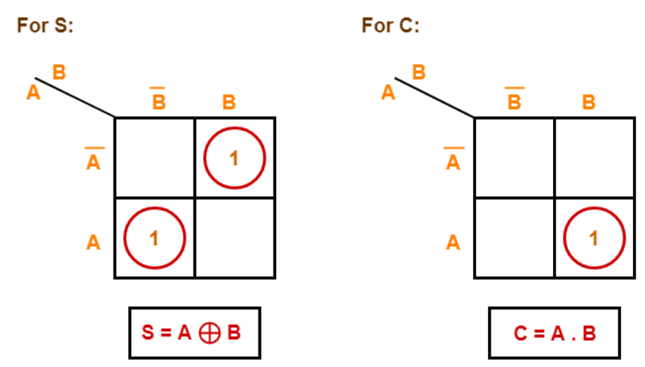
Half adder
By minimizing using K-map, the reduced relations for Sum and Carry bits are obtained as
Sum (S) = A’B +AB’ = A (XOR) B
Carry (C) = AB

Slide 9
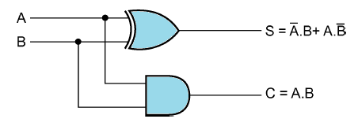
Half adder
The combinational circuit for half adder can be realized using
one XOR gate to calculate Sum (S) and
one AND gate to calculate Carry (C)

Slide 10

full adder
Combinational circuit that performs arithmetic addition
Follows the rules of binary addition
Half adder can add only two bits at a time, no provision to add carry generated from previous bit addition. To resolve this, full adder circuit is designed
There are three inputs each of one bit: addend ‘A’, augend ‘B’ and carry from previous bit addition called carry-in ‘C_{in}’ i.e. [A + B + C_{in}]
The outputs are a sum bit ‘S’ and a carry bit called carry-out ‘C_{out}’.
This carry bit, C_{out}, is propagated to next significant bit for subsequent addition or provided as the output

Slide 11
full adder
The truth table for full adder (FA) with three inputs (A,B, C_{in}) and two outputs (S,C_{out}) is
Inputs |  |  | Outputs
A | B | C_{in} | S | C_{out}
0 | 0 | 0 | 0 | 0
0 | 0 | 1 | 1 | 0
0 | 1 | 0 | 1 | 0
0 | 1 | 1 | 0 | 1
1 | 0 | 0 | 1 | 0
1 | 0 | 1 | 0 | 1
1 | 1 | 0 | 0 | 1
1 | 1 | 1 | 1 | 1

Slide 12
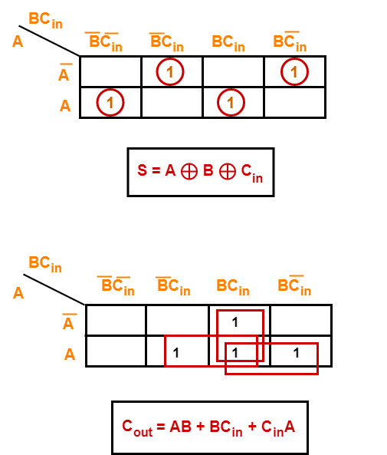
full adder
By minimizing using K-map, the reduced relations for Sum and Carry-out bits are obtained as
Sum (S)
= A’B’C_{in} + A’BC_{in}’ + AB’C_{in}’ + ABC_{in}
= A (XOR) B (XOR) C_{in}
Carry-out (C_{out})
= AB + BC_{in} + AC_{in}
Carry-out (C_{out}) can also be written as
= A’BC_{in} + AB’C_{in} + ABC_{in}’ + ABC_{in}
= C_{in} [A (XOR) B] + AB

Slide 13
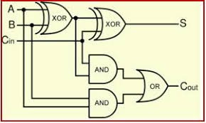
full adder
The combinational circuit for full adder can be realized using
two XOR gates to calculate Sum (S) and
two AND gates and one OR gate to calculate Carry-out (C_{out})

Slide 14
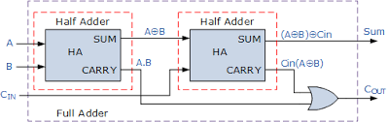
full adder
The full adder can also be realized using two half adders and an OR gate

Slide 15
Half subtractor
Combinational circuit that subtracts one bit from another
Follows the rules of binary subtraction
The inputs are two binary bits, minuend ‘X’ and subtrahend ‘Y’ i.e. [X-Y]
The outputs are a Difference bit ‘D’ and a Borrow bit ‘B’
The truth table for half subtractor (HS) with two inputs (X,Y) and two outputs (D,B) is
X
Y
D
B
Half Subtractor
Inputs |  | Outputs
X | Y | D | B
0 | 0 | 0 | 0
0 | 1 | 1 | 1
1 | 0 | 1 | 0
1 | 1 | 0 | 0

Slide 16
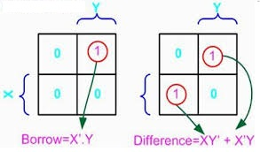
Half subtractor
By minimizing using K-map, the reduced relations for Difference and Borrow bits are obtained as
Difference (D) = X’Y +XY’ = X (XOR) Y
Borrow (B) = X’.Y

Slide 17
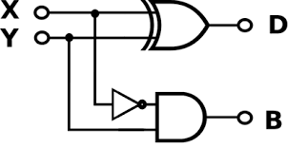
Half subtractor
The combinational circuit for half subtractor can be realized using
one XOR gate to calculate Difference (D) and
one AND gate and one NOT gate to calculate Borrow (B)

Slide 18
full subtractor
Combinational circuit that performs arithmetic subtraction
Follows the rules of binary subtraction
Like half adder, half subtractor can also subtract only two bits at a time. It cannot subtract borrow generated from previous bit subtraction. To resolve this, full subtractor circuit is designed
There are three inputs each of one bit: minuend ‘X’, subtrahend ‘Y’ and borrow from previous bit subtraction called borrow-in ‘B_{in}’ i.e. [X-Y-B_{in}]
The outputs are a Difference bit ‘D’ and a borrow bit called carry-out ‘B_{out}’.
This borrow bit, B_{out}, is propagated to next significant bit for subsequent subtraction or provided as the output
X
Y
D
B_{out}
Full Subtractor
B_{in}

Slide 19
full subtractor
The truth table for full subtractor (FS) with three inputs (X,Y, B_{in}) and two outputs (D, B_{out}) is
Inputs |  |  | Outputs
X | Y | B_{in} | D | B_{out}
0 | 0 | 0 | 0 | 0
0 | 0 | 1 | 1 | 1
0 | 1 | 0 | 1 | 1
0 | 1 | 1 | 0 | 1
1 | 0 | 0 | 1 | 0
1 | 0 | 1 | 0 | 0
1 | 1 | 0 | 0 | 0
1 | 1 | 1 | 1 | 1

Slide 20
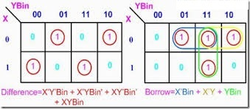
full subtractor
Using K-map, the reduced relations for D and B_{out} are obtained as
Difference (D) = X’Y’B_{in} + XYB_{in} + X’YB_{in}’ + XY’B_{in}’
= X (XOR) Y (XOR) B_{in}
Borrow-out(B_{out}) = X’Y + X’B_{in} + YB_{in}
Borrow-out (B_{out}) can also be written as
= X’Y’B_{in} + XYB_{in} + X’YB_{in} + X’YB_{in}’
= B_{in} [X (XOR) Y]’ + X’Y

Slide 21
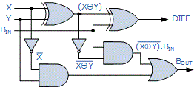
full subtractor
The combinational circuit for full subtractor can be realized using
two XOR gates to calculate Difference (D) and
two AND gates, two NOT gates and one OR gate to calculate Borrow-out (B_{out})

Slide 22
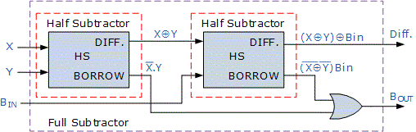
full subtractor
The full subtractor (FS) can also be realized using two half subtractors (HS) and an OR gate

Slide 23
binary Parallel adder
Binary Parallel adder performs addition of two ‘n-bit’ binary numbers, addend A and augend B, in parallel
n-bit addition requires ‘n’ Full-adders
Addition of Least significant bits (LSBs) of A and B can be done by either by a half-adder or a full-adder
Full adders are connected in chain
The C_{out} of each full-adder is connected to C_{in} of next higher order full-adder
Addition generates the sum bits as parallel outputs
Addition of two 4-bit numbers, A₃A₂A₁A₀ and B₃B₂B₁B₀, will result in sum S₃S₂S₁S₀ and final output carry (generated after addition of A₃ and B₃)
Will require 4 Full-adders cascaded such that C_{out} of FA₀ is connected to C_{in} of FA₁ , C_{out} of FA₁ is connected to C_{in} of FA₂ and so on
Also called as RIPPLE CARRY ADDER

Slide 24
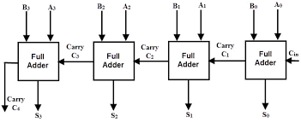
binary Parallel adder
Addition of two 4-bit numbers, A₃A₂A₁A₀ and B₃B₂B₁B₀, requires 4 full-adders
Outputs are 4-bit Sum S₃S₂S₁S₀ and a final output carry (C₄) due to addition of bits A₃ and B₃
All the respective bits of A and B are added simultaneously to generate the sum bit and carry for next bit position

Slide 25
Binary adder―subtractor
Subtraction of two binary numbers can be performed using Binary Parallel Adder
Adding 2’s complement of subtrahend to minuend is equivalent to subtracting subtrahend from minuend
A − B = A + (2’s complement of B)
2’s complement of B is obtained using
inverters to calculate 1’s complement
Then adding ‘1’ at LSB through carry-in (C_{in}) of Binary parallel adder
A common circuit called binary adder―subtractor can perform both addition and subtraction of two binary numbers
Exclusive – OR gates are included at input of each full-adder circuit to convert the binary parallel adder into binary adder-subtractor circuit

Slide 26
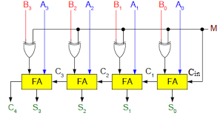
Binary adder―subtractor
This circuit performs addition or subtraction of two 4-bit numbers, A (A₃A₂A₁A₀) and B (B₃B₂B₁B₀).Output will be 4-bit Sum (S₃S₂S₁S₀) and output carry, C₄
MODE input ‘M’ controls the binary operation to be performed. ‘B’ is Ex-ORed with ‘M’ and provided as an input to full-adder
M = 0 → B (XOR) M = B (XOR) 0 = B
FAs have inputs A, B, and C_{in} (=0). The circuit works as a Binary Adder
M = 1 → B (XOR) M = B (XOR) 1 = B’
FAs have inputs A, B’, and C_{in} (=1)
B’ and C_{in}=1, together forms 2’s complement of B. The circuit works as a Binary Subtractor. [A-B = A+(2’s complement of B)]

Slide 27
serial adder
Serial Adder adds bits of two binary numbers in serial order
Only one pair of bits are added at a time, therefore only one Full-adder is required for addition of addend (A) and augend (B)
Input bits are stored in registers and shifted out, one bit at a time, as inputs to the full adder
Addition of serial input bits start from the LSBs (A₀, B₀) then (A₁, B₁) and so on till MSBs.
Output Carry (C_{out}) bit generated from any one addition is saved in a flip-flop and provided as input carry (C_{in}) to next higher order bit addition
Output sum is stored in a register
Serial adders are slower than parallel adders, as only one bit is added per clock pulse
They are used where circuit minimization is more important than speed

Slide 28
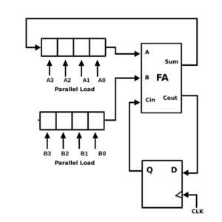
serial adder
Addend (A) and augend (B) are stored in separate registers
Output sum (S) can either be stored in separate register or in same as any of the input

Slide 29
bcd adder
BCD (Binary Coded Decimal) codes or 8421 codes comprises of 4-bit binary representation for decimal digits 0,1,2,3,4,5,6,7,8 and 9 (0000 to 1001)
BCD Adder is the combinational circuit that adds two BCD digits and the sum is also a valid BCD number
The addend and augend are BCD numbers, means each can have any value from 0 (0000) to 9 (1001). Hence, the sum can range only from 0 to 18
Maximum sum that can be obtained by adding two BCD digits is 19, when there in a carry-in from previous digit addition (A + B + C_{in} = 9 + 9 + 1).
Till the Sum is less than or equal to 9 (1001), it can be represented by corresponding single BCD digit. But, for sum in range of 10 to 19, it is represented by two BCD digits i.e. 10 is (0001 0000);15 is (0001 0101);19 is (0001 1001)

Slide 30
bcd adder
BCD adder circuit comprises of a correction circuit to detect and perform the required conversion of sum from non-valid BCD value to valid BCD value
The steps for performing BCD addition are
Add the two 4-bit BCD digits using binary parallel adder
For the positions where the sum is equal to or less than 9, the sum is a valid BCD number and therefore, no correction is required
For the positions where the sum is greater than 9 and less than or equal to 19, the sum is a non-valid BCD number. Therefore, the correction is required
Correction is done by adding binary 6 (0110) to the obtained sum. Adding ‘6’ maps the binary sum to its equivalent valid BCD number. An output carry (C) is also produced for next digit addition
The necessary condition that should be ‘TRUE’ or ‘1’ for the correction circuit to operate is calculated from the truth table that maps Binary sum into the equivalent BCD sum

Slide 31
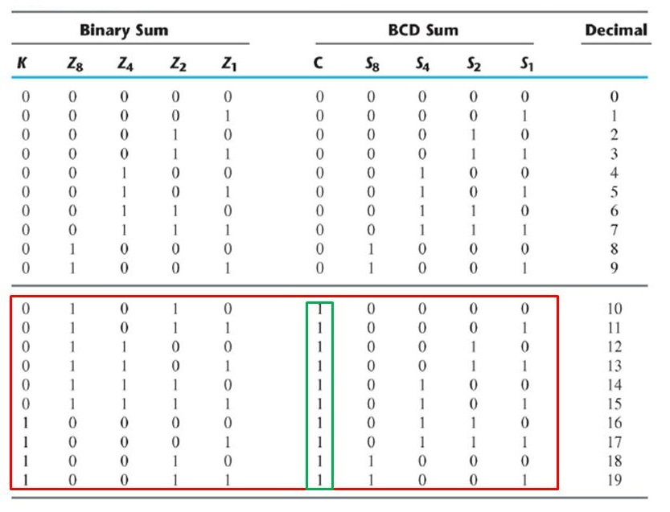
bcd adder
Truth table for mapping Binary sum (KZ₈Z₄Z₂Z₁) to BCD sum(CS₈S₄S₂S₁). The correction is required when
Output carry in Binary Sum (K) =1
Z₈ is 1 and either of Z₄ and Z₂ is 1 → Z₈ Z₄ + Z₈ Z₂ = 1
Hence, C = K + Z₈ Z₄ + Z₈ Z₂ has to be 1 for 6 (0110) to be added

Slide 32
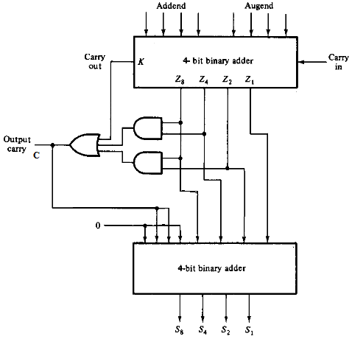
bcd adder
BCD adder comprises of two 4-bit binary adder circuits
First binary adder adds Addend and Augend, with input carry, C_{in} to generate Binary sum (KZ₈Z₄Z₂Z₁)
Using K, Z₈, Z₄ and Z₂, value of output carry (C) is calculated
If C = 0, then nothing is added to binary sum. The BCD sum is same as binary sum
If C = 1, then binary 0110 is added to binary sum through second binary adder. The binary sum is mapped to equivalent BCD sum with output carry (C) as 1

Slide 33
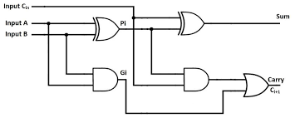
Look ahead carry adder
In Parallel adder, the speed of addition is controlled by the time required by the carry inputs to propagate through all the FAs
All the addend and augend bits are already loaded to each FA, but the sum bit can only be calculated after the value of carry-in is propagated and available for addition
In a 4-bit parallel adder, the total propagation time taken by the carry-out to propagate will be time taken in eight logic gates
For n-bit parallel adder, propagation time for carry-out is ‘2n’ gate levels, hence, the limiting factor for the speed

Slide 34
Look ahead carry adder
LOOK AHEAD CARRY adder speeds up the addition by reducing the propagation delay time
All the input bits are examined simultaneously and carry-in bits, for all stages, are also generated simultaneously
Two additional functions are incorporated in this adder to speed up the addition process
Carry Generate(G_{i}): provides the output carry when both A and B are ‘1’, irrespective of value of carry-in (C_{i})
G_{i} = A_{i}.B_{i}
Carry propagate (P_{i}): function associated with the propagation of carry from C_{i} to C_{i+1}
P_{i} = A_{i} (XOR) B_{i}
Sum and Carry-out are
S_{i} = P_{i} (XOR) C_{i}
C_{i+1} = G_{i} + P_{i}.C_{i}
where i=0,1,..,3, denotes the bit position being added in FA and the stage in parallel adder

Slide 35
Look ahead carry adder
Using equation for carry-out (C_{i}) of each stage
C_{i+1} = G_{i} + P_{i}.C_{i}
The equation for carry-out of each full-adder becomes
C₁ = G₀ + P₀.C₀
C₂ = G₁ + P₁.C₁
C₃ = G₂ + P₂.C₂
C_{out} = C₄ = G₃ + P₃.C₃
Substituting the values of C_{i} in these, we get
C₁ = G₀ + P₀C₀
C₂ = G₁ + P₁C₁
= G₁ + P₁ (G₀ + P₀C₀)
= G₁ + P₁G₀ + P₁P₀C₀
C₃ = G₂ + P₂.C₂
= G₂ + P₂ (G₁ + P₁G₀ + P₁ P₀C₀)
= G₂ + P₂G₁ + P₂P₁G₀ + P₂P₁ P₀C₀

Slide 36
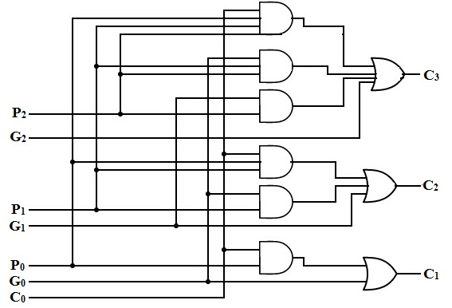
Look ahead carry adder
It is evident from the equations of C₁, C₂ and C₃, that only one level of AND gate followed by an OR gate will generate each carry-out
Generation of C₃ does not require C₂ and C₁ to get propagated (as in case of Parallel adder). They all are propagated at the same time
Logic expressions for each ‘C_{i}’ in look ahead carry generator:
C₁= G₀ + P₀C₀
C₂= G₁ + P₁G₀ + P₁ P₀C₀
C₃=G₂ +P₂G₁ +P₂P₁G₀+P₂P₁ P₀C₀

Slide 37
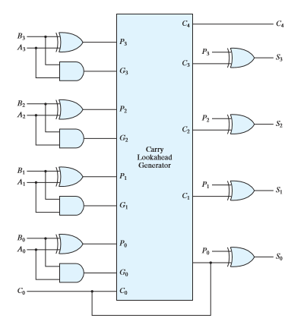
Look ahead carry adder
For all i = {0,1,2,3}, P_{i} is generated by an XOR gate and G_{i} by an AND gate
Carries are propagated through look ahead carry generator and provided as inputs to second XOR gates
All output carries are generated after delay of two levels of gates
Each Sum bit requires only two XOR gates
Sums S₀ – S₃ are generated with equal propagation delays

Slide 38
Problems (TBD)
TBD

